Slide 1

Indian Institute Of Technology Guwahati
Department Of Physics
Preparation Of Schrodinger Cat States:
A Comprehensive Study
Akash Vaishnav
Roll No. - 212121005
Supervisor – Prof. Amarendra Kumar sarma
M.Sc Project Presentation
May 4, 2023

Slide 2
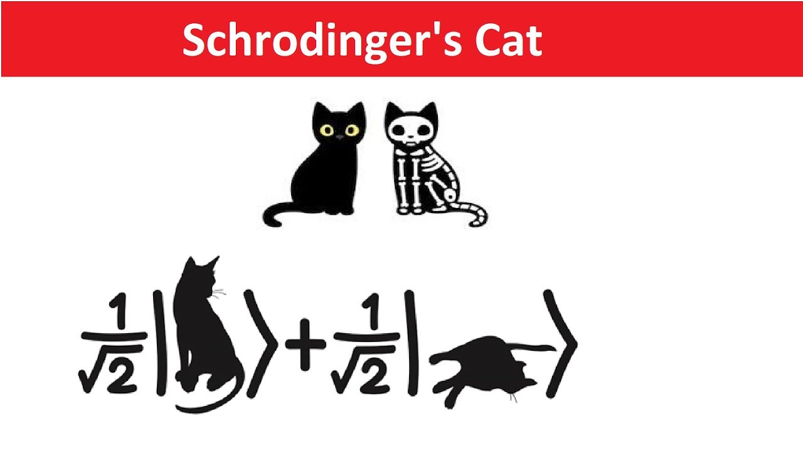
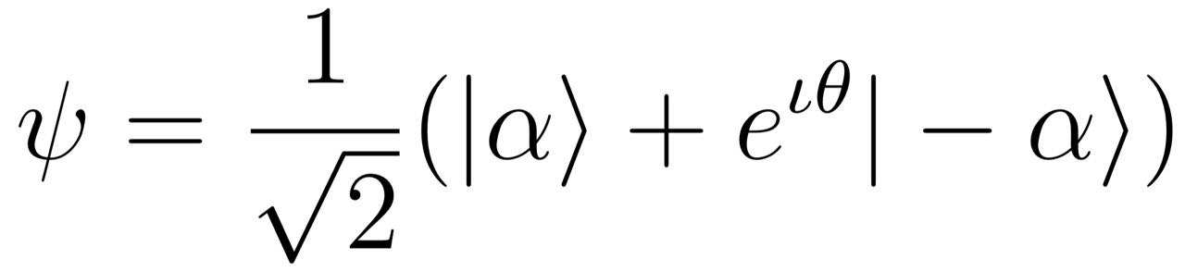
Introduction
:-
Schrodinger cat states are the quantum
superposition of two macroscopically
distinct states analogous to the famous
thought The experiment proposed by
Erwin Schrodinger in 1935:
And the general mathematical expression for the Schrodinger cat state is given as

Slide 3
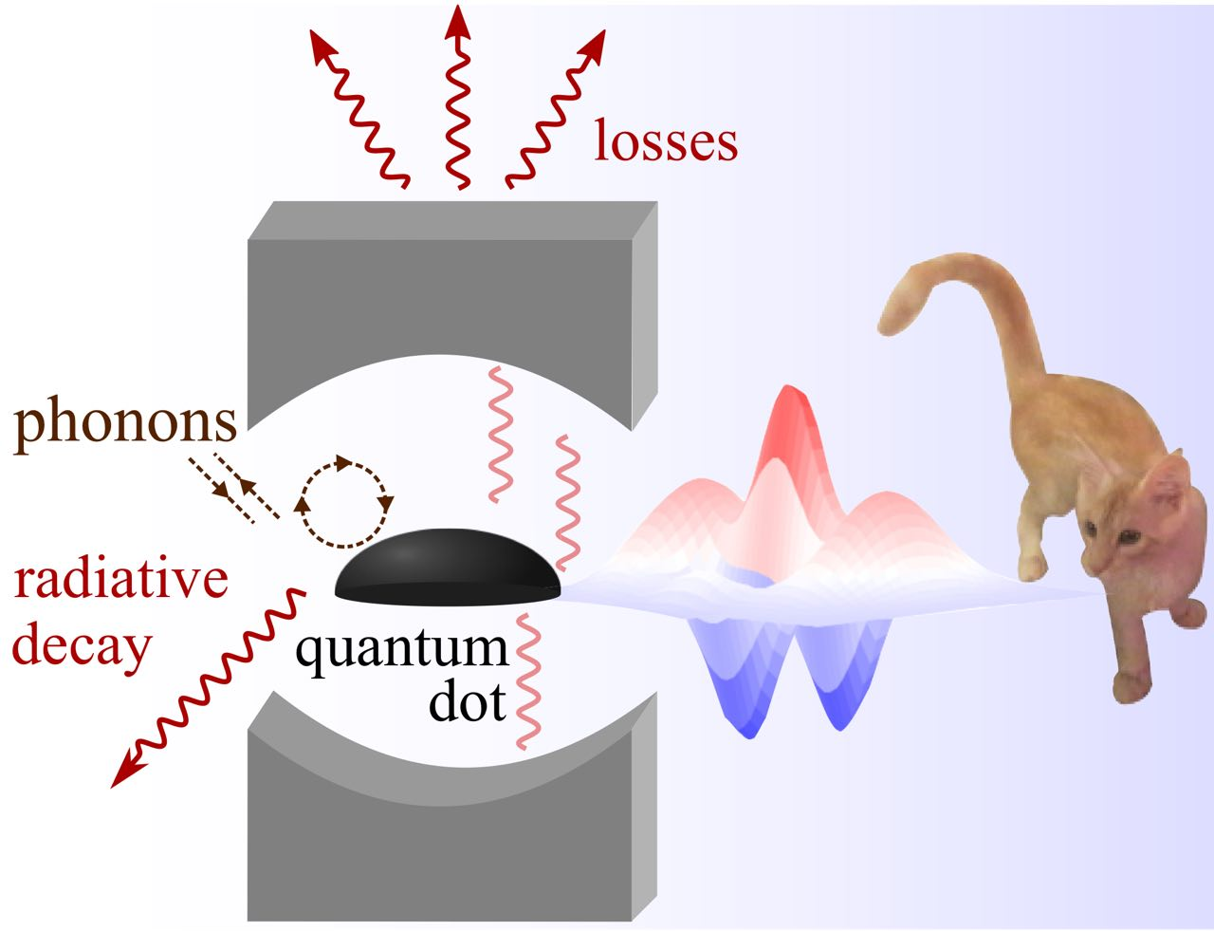
Schrodinger Cat States in Quantum Dot Cavity Systems
:-
1. Quantum dots are nanoscale semiconductor structures with unique
electronic and optical properties that can be precisely engineered using
advanced semiconductor fabrication techniques.
2. Quantum dots offer a unique platform for studying the behavior of
electrons in confined systems and can simulate the behavior of atoms
and molecules, providing a way to study quantum mechanical effects
in condensed matter systems.
3. Quantum dots have long coherence times, making them attractive for
quantum information processing and communication applications.
4. Quantum dot-cavity systems offer several advantages for quantum
information processing and quantum communication applications, and
the evolution of Schrödinger cat states in these systems has potential
benefits for creating logical qubits and entangled states.

Slide 4
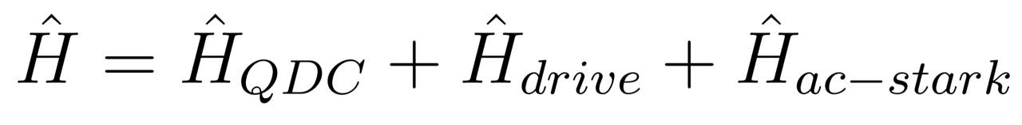
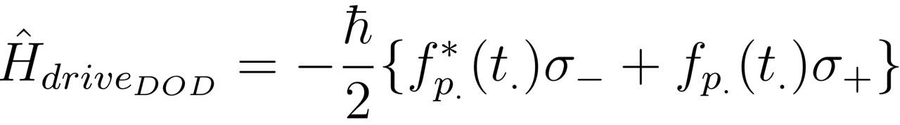
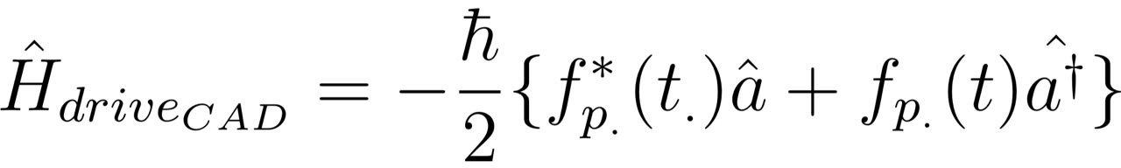
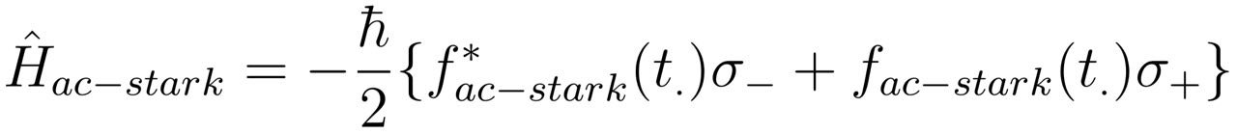
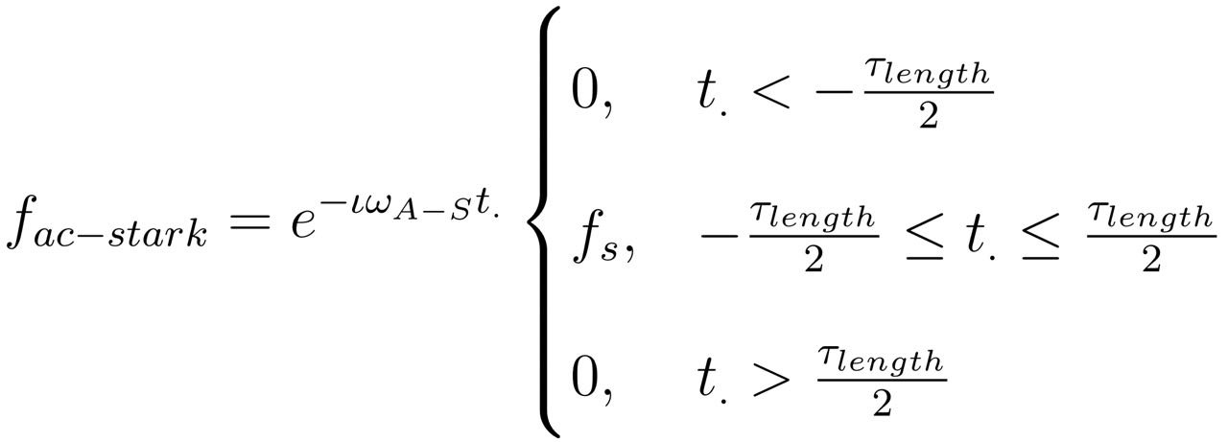
Theoretical Model
:-
Hamiltonian of the system:
QDC Hamiltonian From the JC model :
The driving Hamiltonian for DOD protocol
The driving Hamiltonian for CAD protocol
To decouple the quantum dot and cavity : Hamiltonian for AC-Stark pulses
Where ,

Slide 5
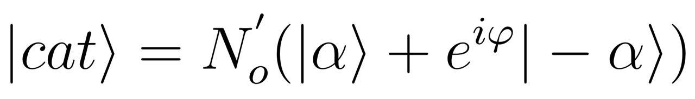

Dot Driven Protocol
1. Target state for this protocol –
2. We adopt the protocol suggested by C.K. Low and Eberly
3. Initially proposed protocol does not consider loss channels
4. Requirements: driven Jaynes Cummings model with controllable driving f(t) and coupling g(t) between two-level system and cavity
5. Obstacles in transferring proposals to QDCs
6. Time-dependent driving of QDC is possible with laser pulses, but controlling QD-cavity coupling is time-dependently challenging
7. Challenge in implementing the protocol in QDC is twofold: (1) the varying magnitude of QD-cavity coupling, and (2) QD and cavity decoupled during driving
8. Problem (1) solved by varying time intervals while keeping coupling constant
9. Decoupling can be avoided if short enough pulses can achieve the desired goal
10. Gaussian pulse with the same area as rectangular fiτ used to reduce experimental demand, with FWHM of 100 fs vastly
,Where α = $π$/2 and $∅$=0 is taken

Slide 6
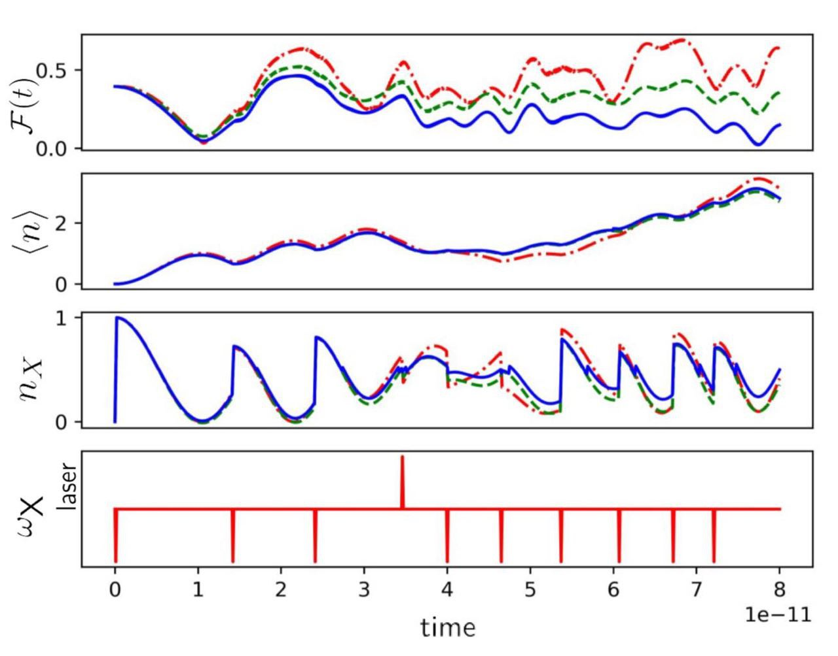
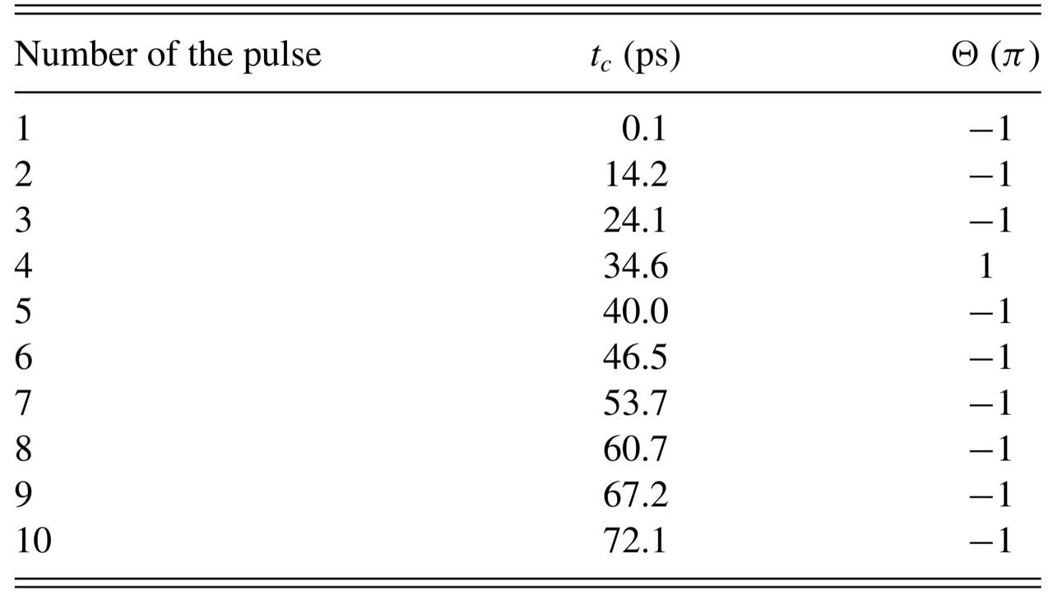
Implementation Of Protocol:-
Pulse Sequence for DOD protocol
Dynamics of the DOD protocol

Slide 7
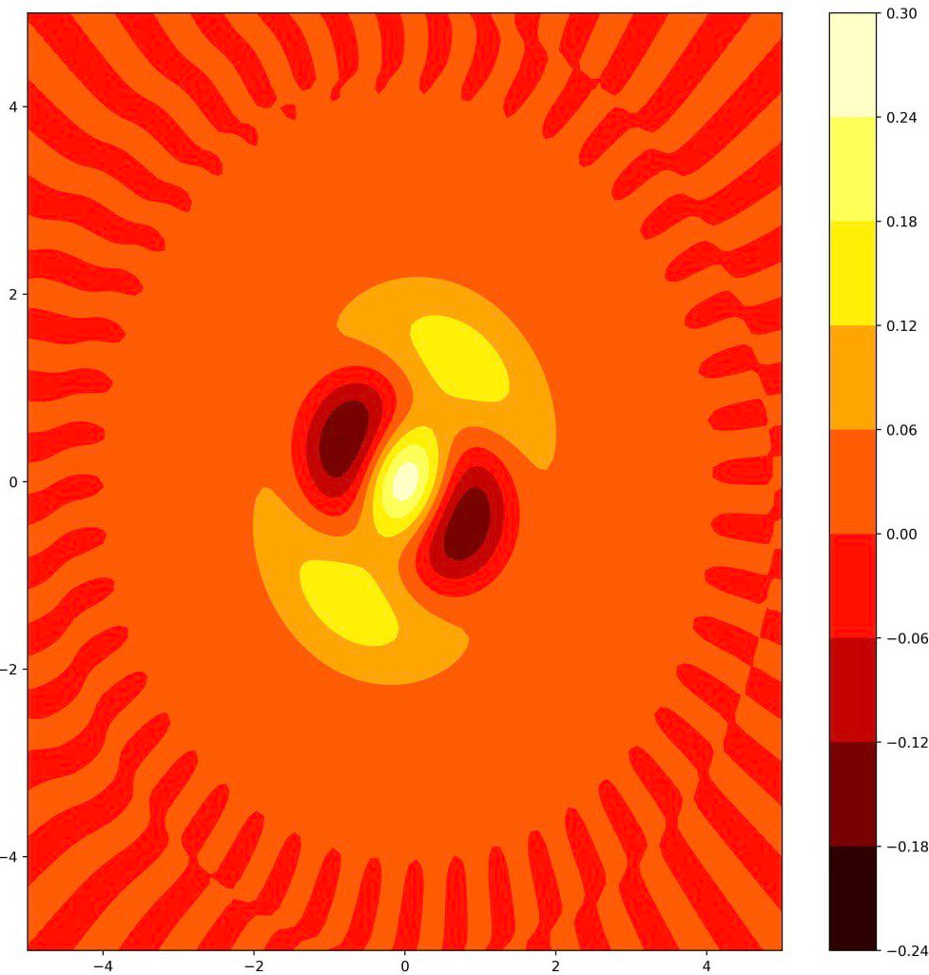
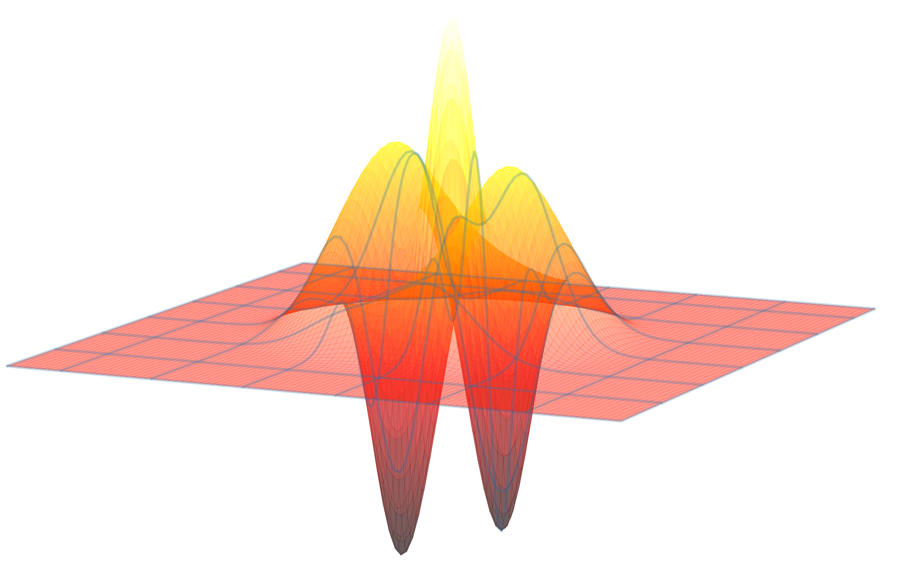
Wigner functions of the photonic states by the DOD protocol
For the Ideal case

Slide 8
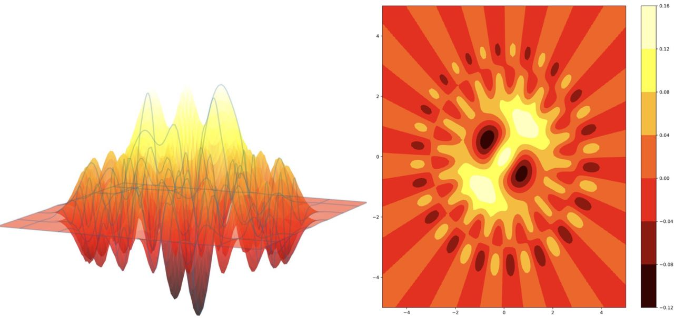
With radiative decay of quantum dot and cavity losses

Slide 9
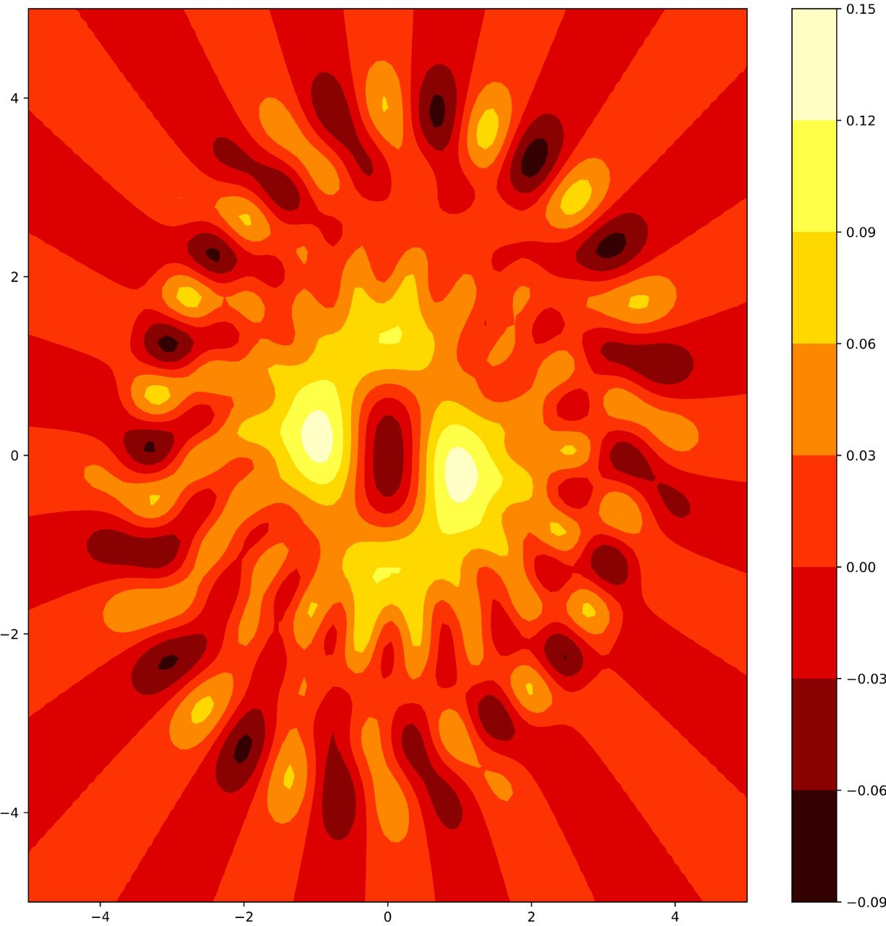
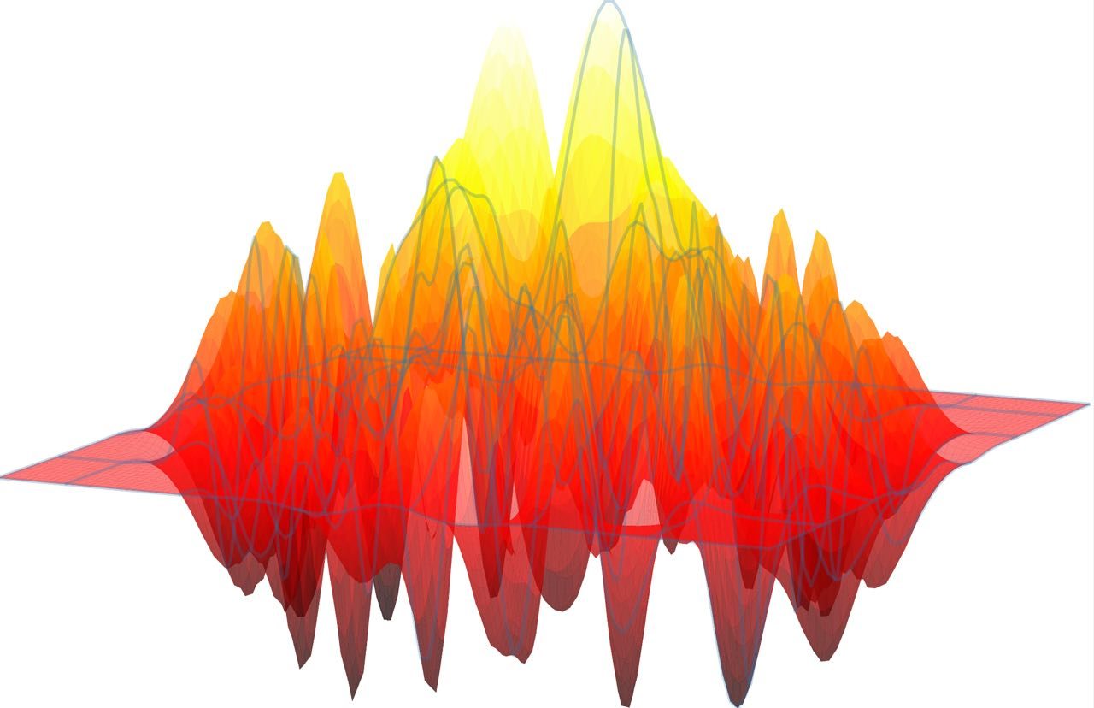
For all kinds of losses (including phonon loss)

Slide 10
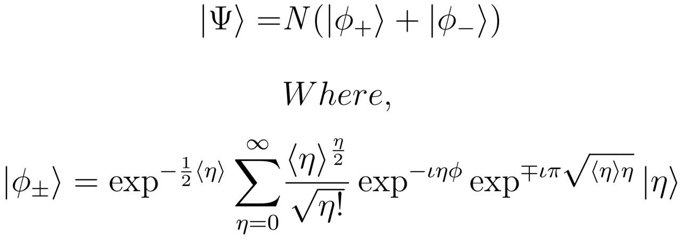
Cavity Driven Protocol
1. We adopt the protocol suggested by Julio Gea-Banacloche.
2. The CAD protocol for preparing Schrödinger-cat states is based on the collapse-and-revival
example in the Jaynes-Cummings model.
3. The initial state of the Jaynes-Cummings dynamics must be coherent in the cavity mode.
4. The Photonic state prepared at half the revival time is
5. The fidelity of the prepared cat state is highest when the mean photon number is
large, but this increases the preparation time and exposure to losses.
6. Task 1 of the protocol, preparing the initial state, is solved by driving the cavity mode
with a short Gaussian pulse.
7. Task 2 finds the optimal value of n for maximum fidelity to the cat state.

Slide 11
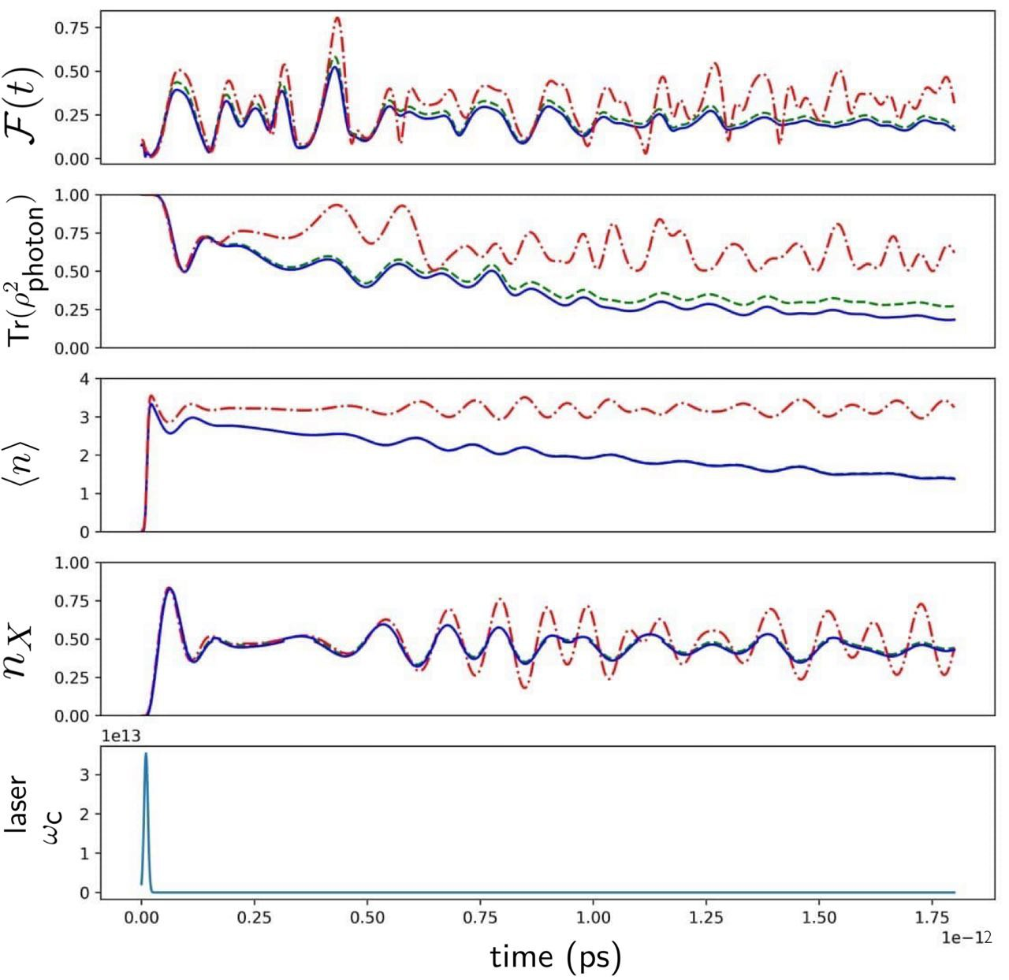
Implementation Of Protocol:-
Dynamics of Cavity-Driven Protocol
1. Figure shows the dynamics of QDC in CAD Protocol with a pulse area of 1.2π.
2. Average photon number is about 3, not high enough for a clear collapse-and-revival signature.
3. Fidelity (F) shows oscillations within a bell-like envelope, reaching the maximum of 78% at 42.3 ps after the pulse.
4. QD and photon subspaces factorize at
maximum fidelity.

Slide 12
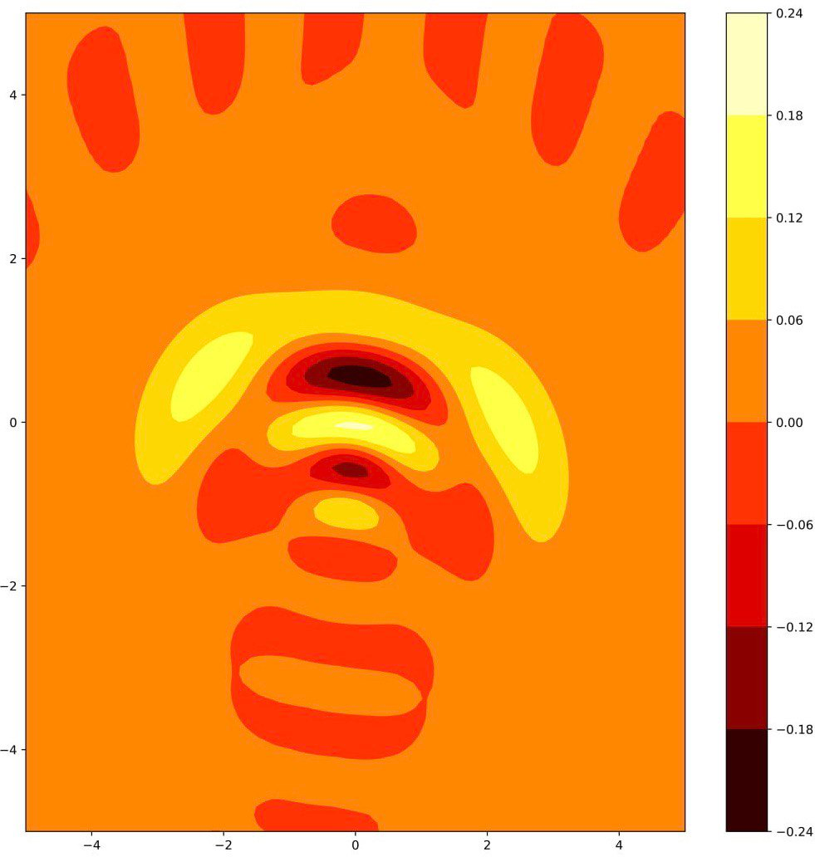
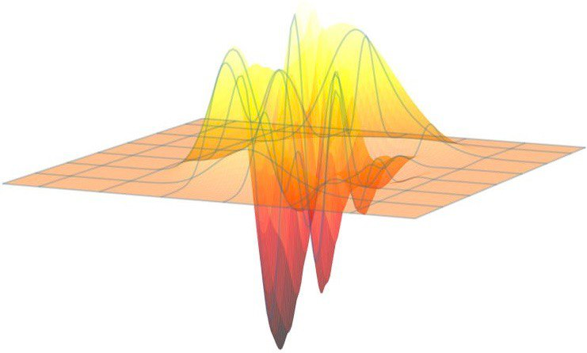
Wigner functions of the photonic states by the CAD protocol
For the Ideal case

Slide 13
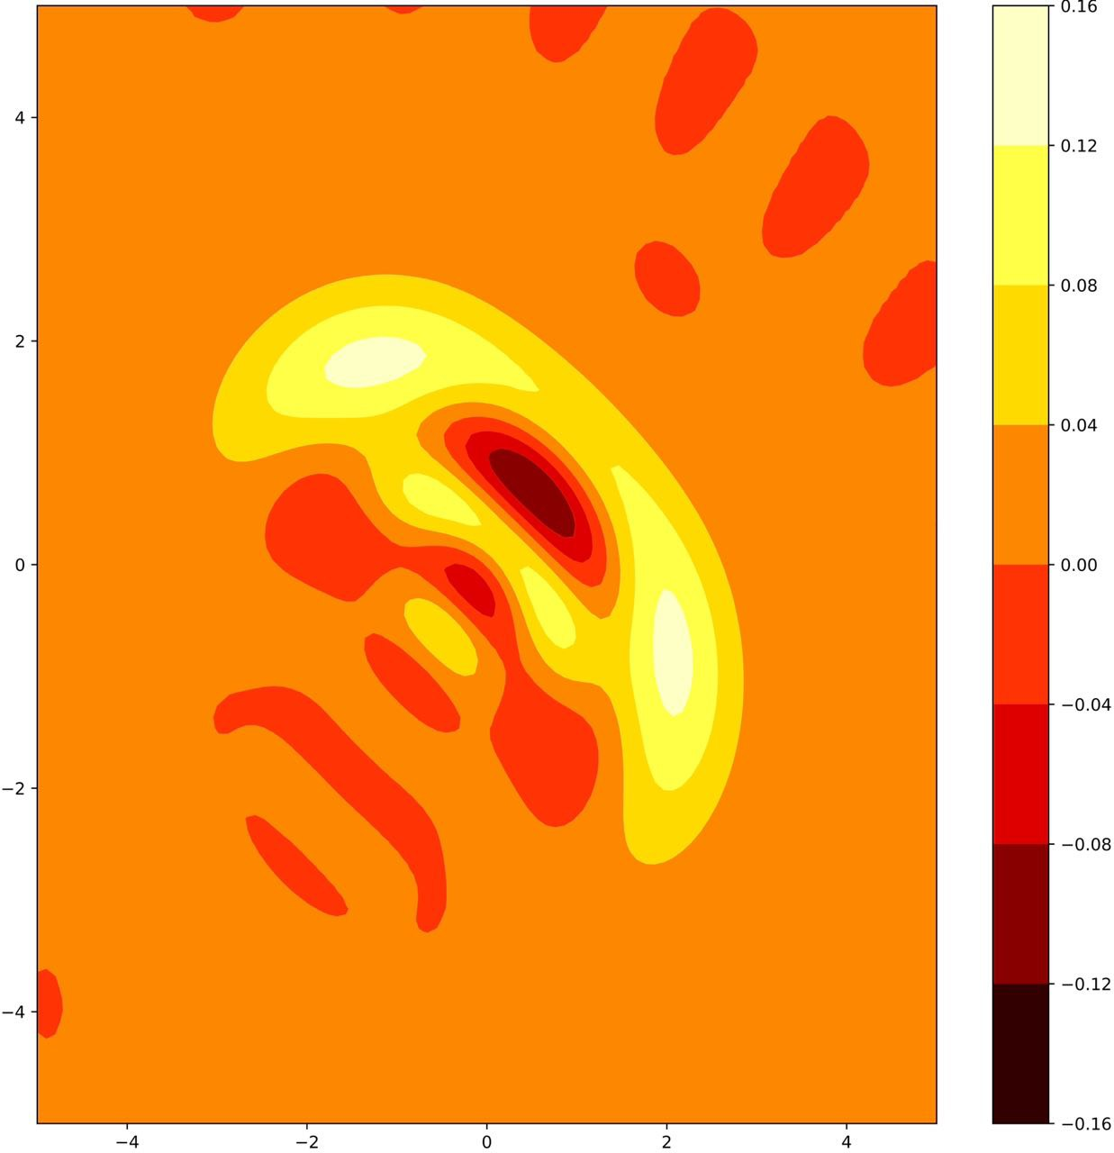
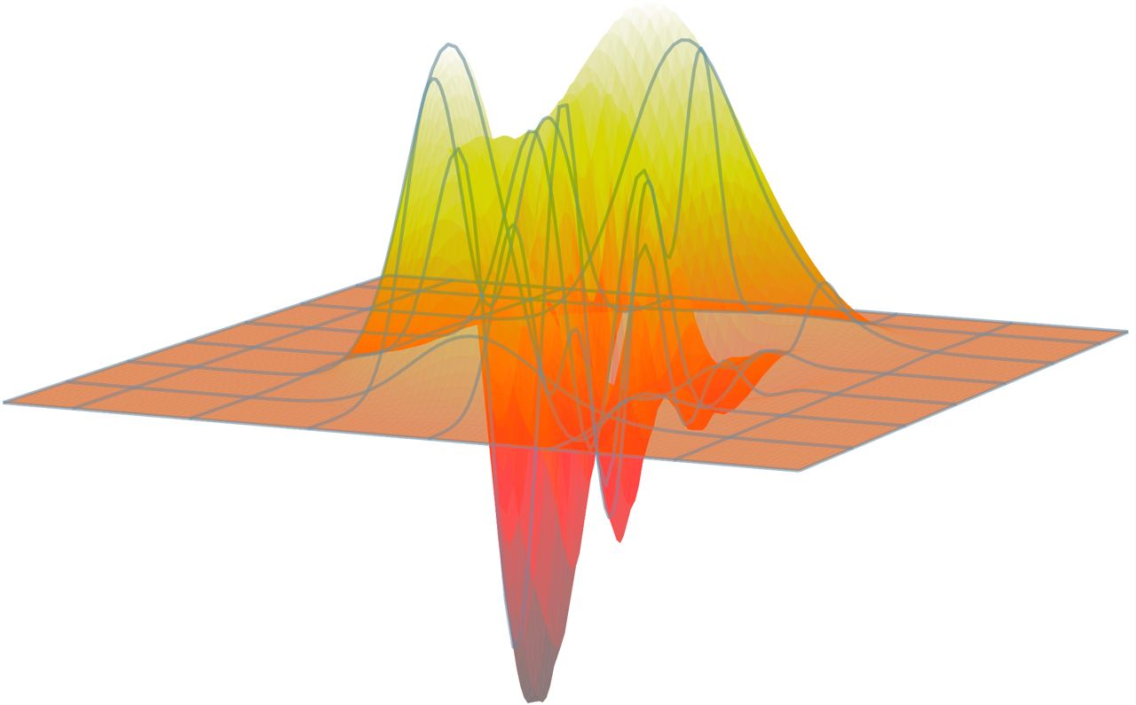
With radiative decay of quantum dot and cavity losses

Slide 14
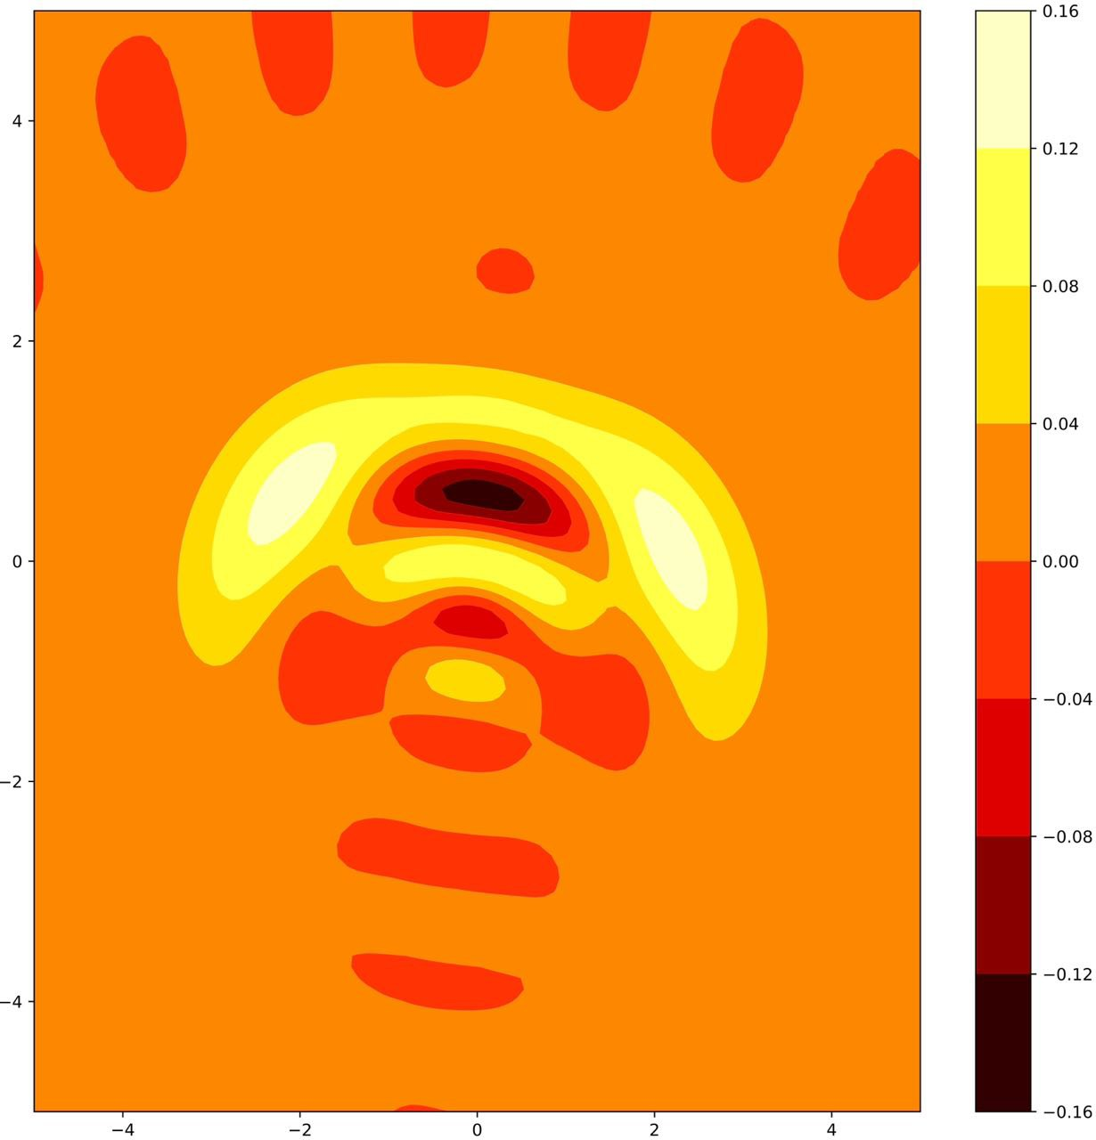
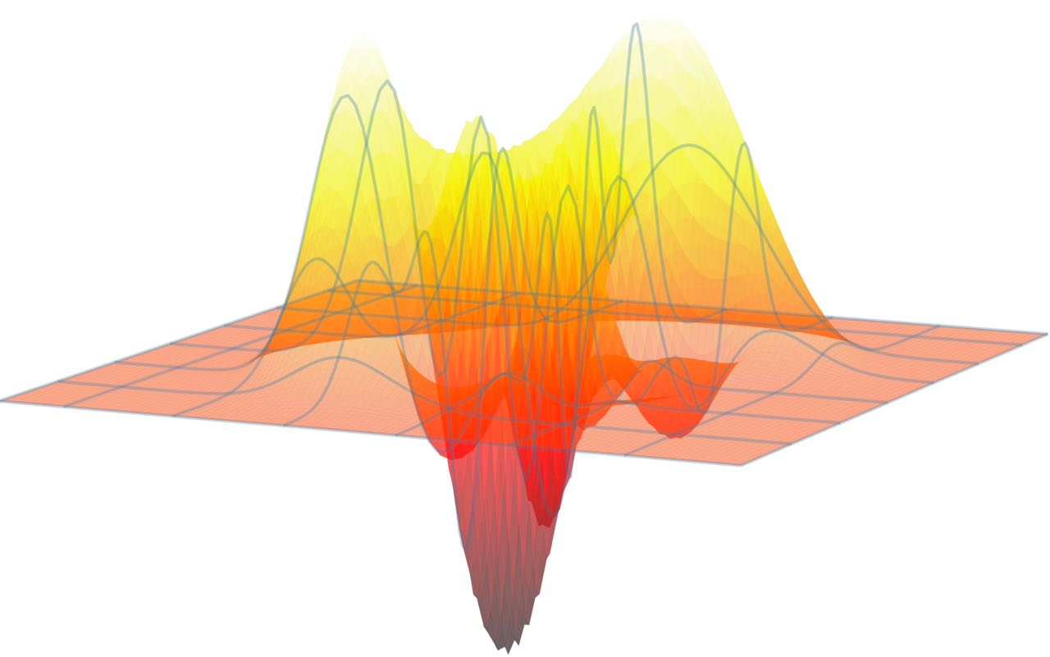
For all kinds of losses (including phonon loss)

Slide 15
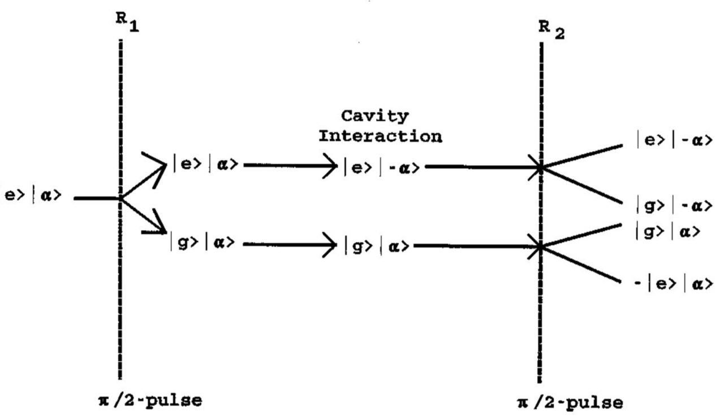
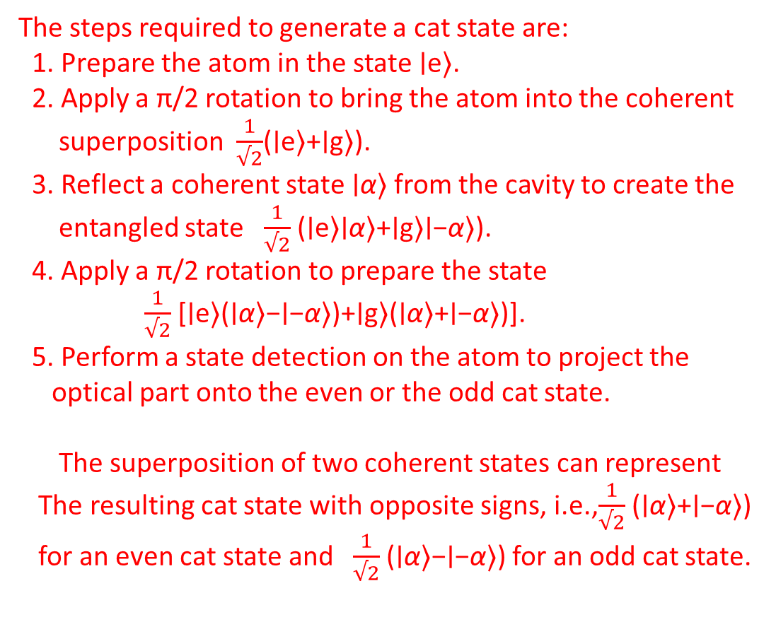
Generating Nonclassical Atom-Light States
via Deterministic Entanglement
The steps required to generate a cat state are:
1. Prepare the atom in the state ∣e⟩.
2. Apply a π/2 rotation to bring the atom into the coherent
superposition $\frac{1}{√2}$(∣e⟩+∣g⟩).
3. Reflect a coherent state ∣α⟩ from the cavity to create the
entangled state $\frac{1}{√2}$​(∣e⟩∣α⟩+∣g⟩∣−α⟩).
4. Apply a π/2 rotation to prepare the state
$\frac{1}{√2}$​[∣e⟩(∣α⟩−∣−α⟩)+∣g⟩(∣α⟩+∣−α⟩)].
5. Perform a state detection on the atom to project the
optical part onto the even or the odd cat state.
The superposition of two coherent states can represent
The resulting cat state with opposite signs, i.e.,$\frac{1}{√2}$​(∣α⟩+∣−α⟩)
for an even cat state and $\frac{1}{√2}$​(∣α⟩−∣−α⟩) for an odd cat state.
Ramsey microwave interaction in R1 and R2 zones, combined with cavity interaction at the center, may cause disruptive small pathways and yield significant outcomes.

Slide 16
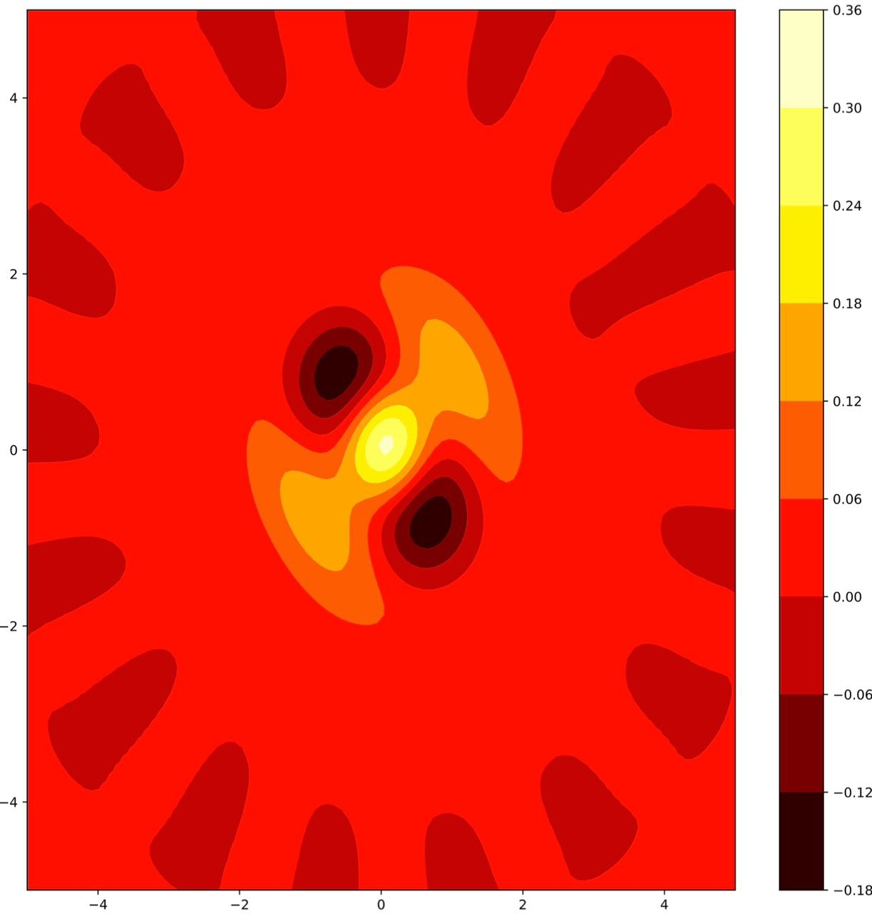
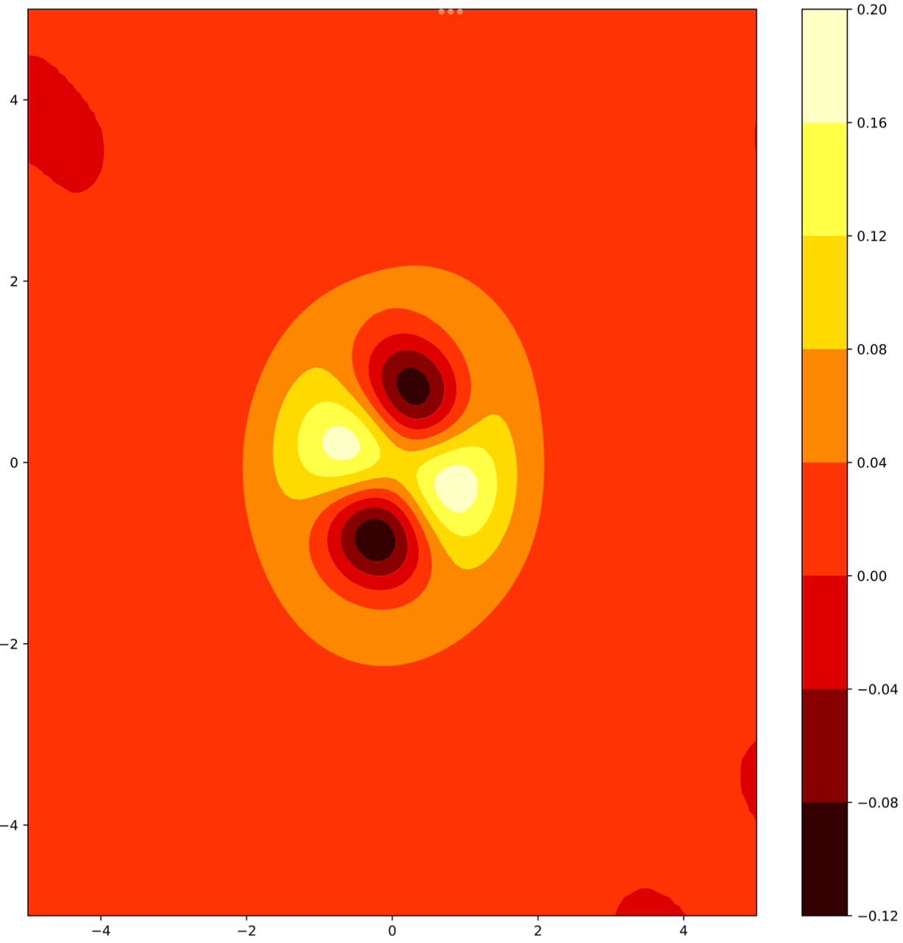
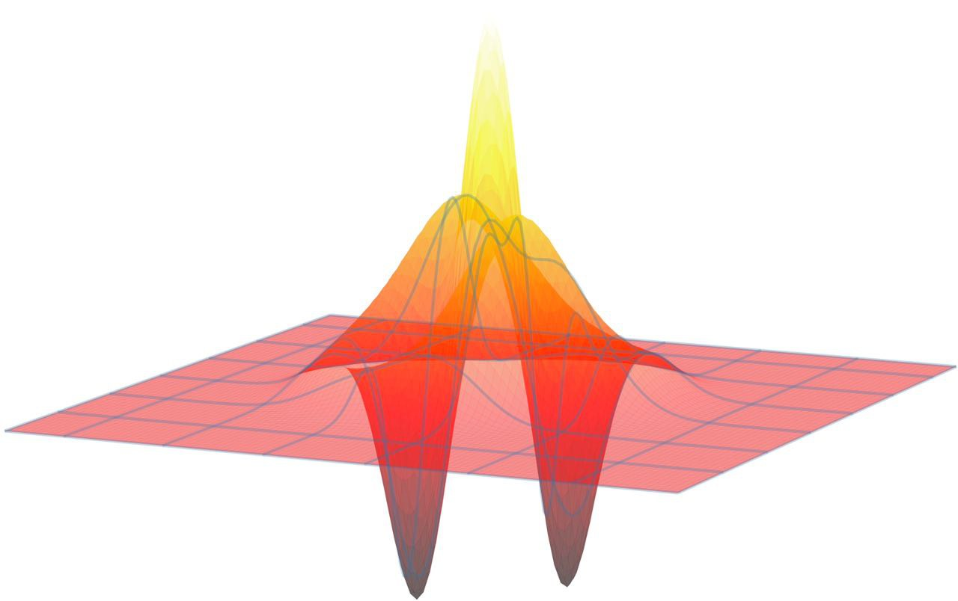
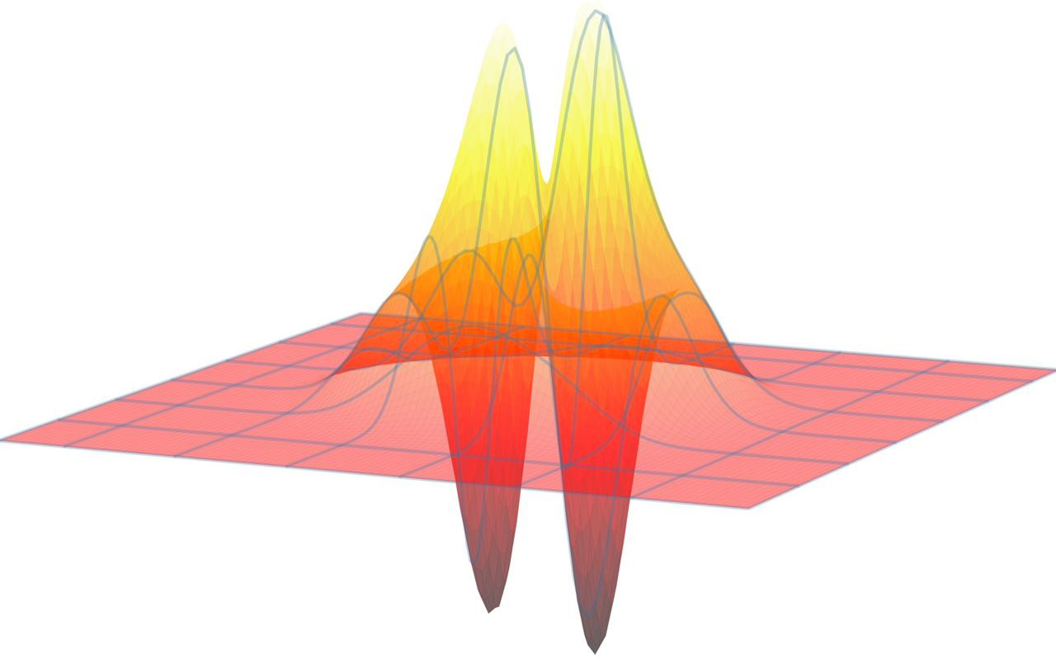
Wigner functions of the photonic states for Ideal case
Even Schrodinger cat state in ideal conditions
odd Schrodinger cat state in ideal conditions

Slide 17
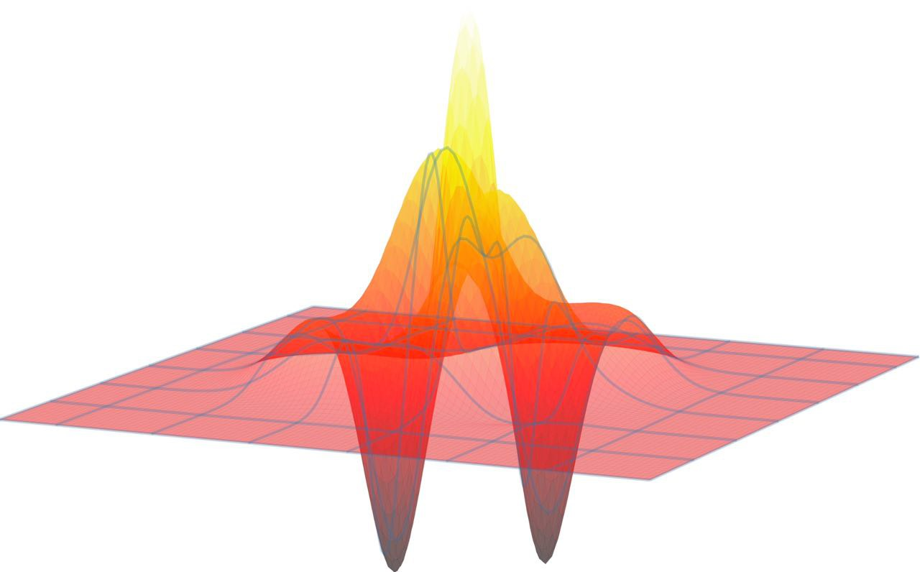
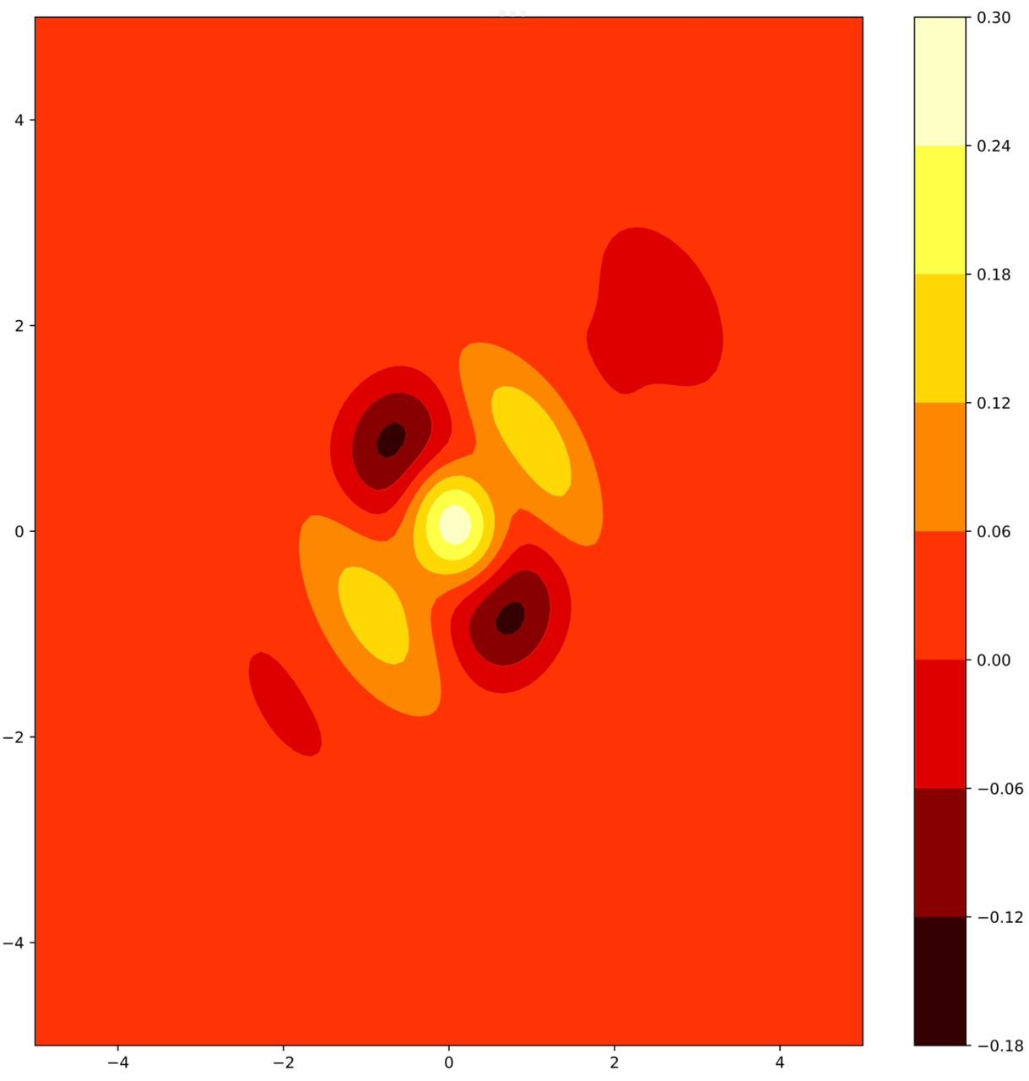
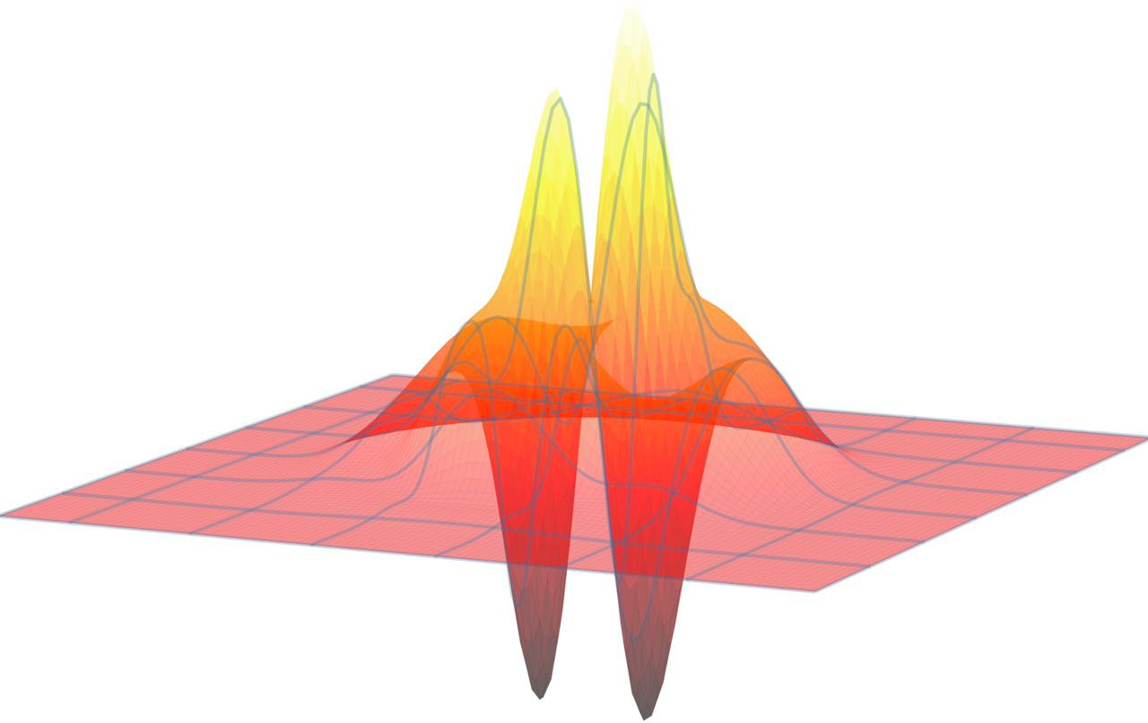
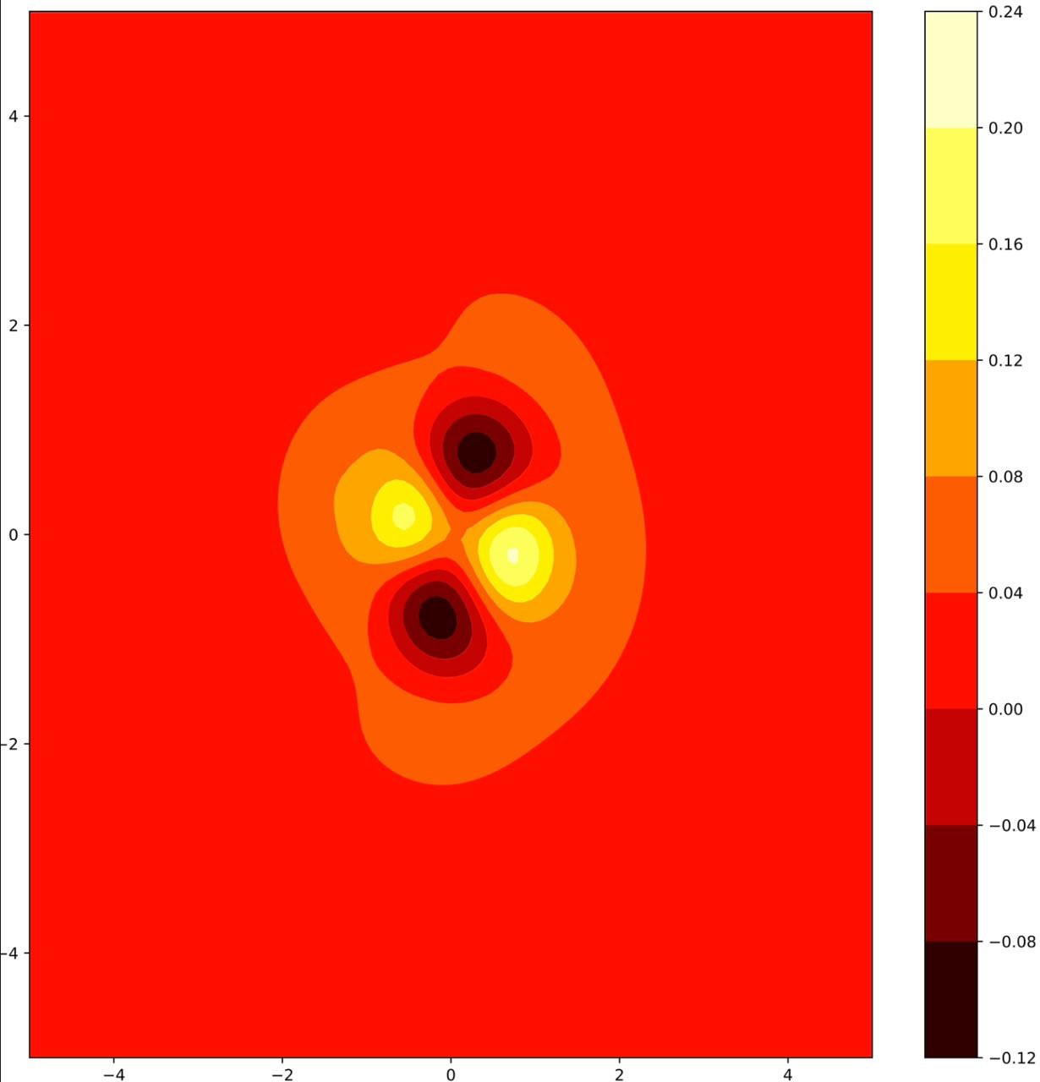
Wigner functions of the photonic states with decay and cavity losses
Even Schrodinger cat state with decay and cavity losses
odd Schrodinger cat state with decay and cavity looses

Slide 18
Conclusion:-
Three protocols for preparing photonic Schrodinger cat states were investigated in solid-state quantum dot-cavity and atom-
cavity systems.
The Deterministic Dot-Driven (DOD) protocol was unsuitable for preparing Schrodinger cat states in realistic QDCs, while the
Cavity-driven (CAD) protocol successfully prepared Schrodinger cat states in QDCs.
The third protocol involved generating Schrodinger cat states in an atom-cavity system via deterministic entanglement, and
prepared more advanced Schrodinger cat states using Ramsey field pulses.
All protocols rely on precise timing and mutual phases of external laser pulses to control the system and prepare the
Schrodinger cat state.
Losses and environmental coupling to longitudinal acoustic phonons can be detrimental to the preparation of Schrodinger
cat states in all protocols.
The findings demonstrate the feasibility of preparing Schrodinger cat states in both QDCs and atom-cavity systems, but
improvements in cavity quality factor and loss reduction are needed for practical applications.
The investigation provides a more detailed understanding of the preparation of Schrodinger cat states and can guide future
research in quantum information processing and quantum communication.

Slide 19
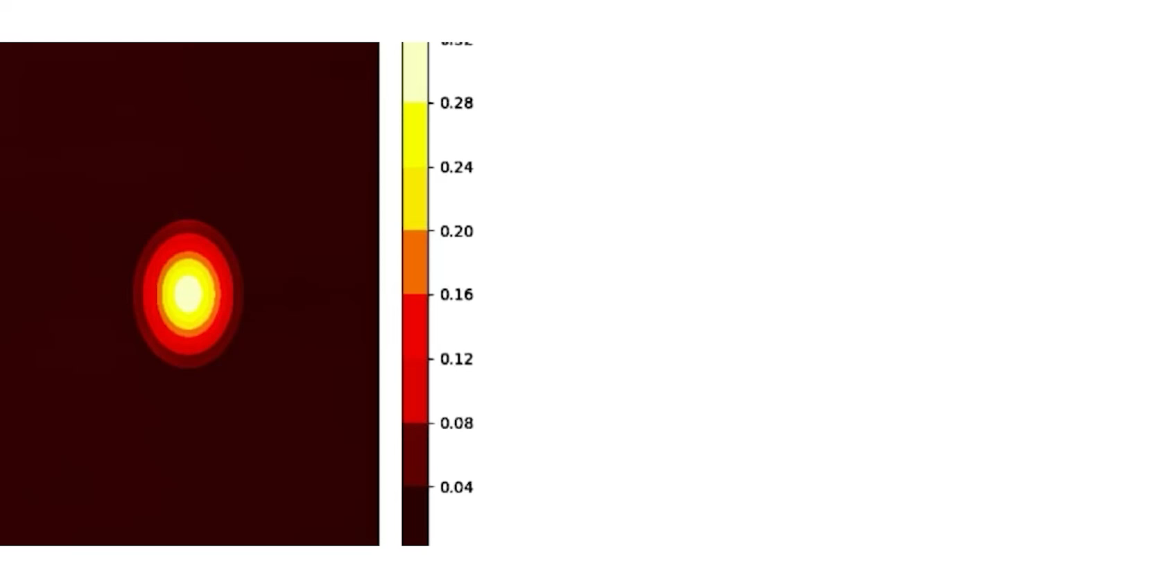
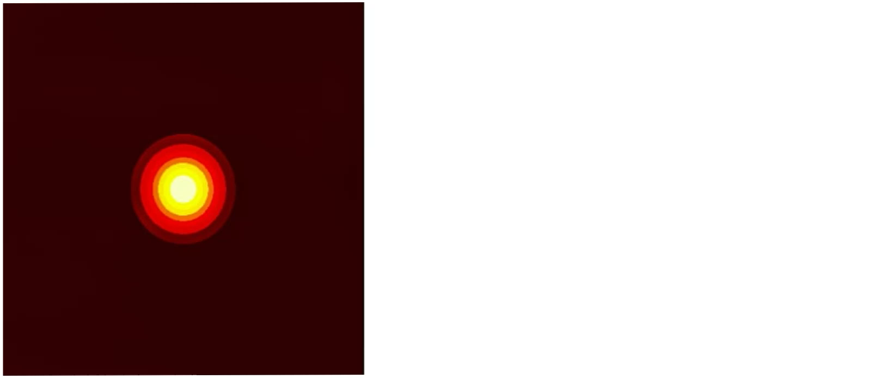
Thank You

